Slide 1
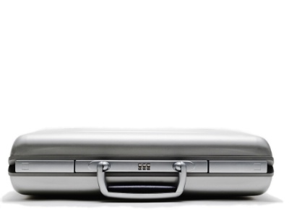
IASB accelerates its redeliberations New decisions on accounting for profit emergence (CSM) and interest rate volatility (OCI)
Francesco Nagari
Deloitte Global IFRS Insurance Lead Partner
27 March 2014

Slide 2
Agenda
Highlights of decisions from IASB meeting in March
Detailed analysis of the IASB Staff recommendations and Board discussions
Update on timetable and next steps

Slide 3
Highlights
IASB meeting on 18 March 2014
Preceded by an education session on the same topics on 13 March 2014
Profit emergence – CSM accounting has been retained but amended
Interest rate volatility – OCI solution has been made optional
Next steps

Slide 4
Overview of discussions
Redeliberation of accounting for changes in estimates
The IASB considered two of the five targeted proposals in its Exposure Draft issued in June 2013, which deal with how entities would account for changes in estimates:
The unlocking of the contractual service margin (CSM)
Presenting the effect of changes in discount rates in other comprehensive income (OCI)
The IASB considered only insurance contracts that have no participating features

Slide 5
Unlocking the contractual service margin
Should the CSM be adjusted for differences between current and previous estimates of the present value of cash flows relating to future coverage or other services?
Staff Recommendation
The difference between the current and previous estimates of the PV of cash flows related to future coverage and other services should be added to, or deducted from, the CSM, subject to the CSM not becoming negative.
Differences not related to future coverage and other future services should be recognised immediately in profit or loss.

Slide 6
Unlocking the contractual service margin (cont.)
Complexity
The staff noted the importance of operational complexity with unlocking/locking, and that the decision should be based on benefits achieved.
Benefits
Unlocking would increase consistency between the CSM accounting on day 1 and day 2.
Results in better representation of the CSM as the unearned profit in a contract.
Consistency in measurement under the Building Block Approach (BBA) and the Premium Allocation Approach (PAA)
The staff noted concerns expressed by commentators about the definition of ‘portfolio’. The level of aggregation for the CSM and unlocking will be addressed at a future IASB meeting
Disadvantages
The main criticism of unlocking is the lack of transparency from recognising changes in estimates through earnings
This could be mitigated by the reconciliation requirements

Slide 7
Unlocking the contractual service margin (cont.)
Unlock only for changes relating to future coverage
Adjustment to the margin only for changes relating to future periods should be made
Margin represents unearned profit that the entity would earn by providing coverage/other services in the future.
The proposal is consistent with IAS 8:
Changes in estimates that have incurred are recognised in the current period
Changes in estimates for future periods to be recognised in the respective future periods
This proposal was supported by most respondents to the 2013 ED.
IASB vote
The IASB unanimously reconfirmed the proposal in the 2013 Exposure Draft captured in the staff recommendation

Slide 8
Treatment of previously recognised losses
Whether to treat the favourable changes in estimates of the PV of cash flows by:
Recognising favourable changes in profit or loss up to previously recognised losses in profit or loss, with any excess changes used to re-establish the CSM
Re-establishing the CSM immediately
Staff Recommendation
Favourable changes in estimates that arise after losses were previously recognised in profit or loss should be recognised in profit or loss to the extent that they reverse those losses
Any excess should be used to re-establish the CSM
Arguments for this change suggest that the benefits outweigh the costs of a more complex accounting system

Slide 9
Treatment of previously recognised losses (cont.)
Should previously recognised losses be reversed?
For
If previously recognised losses are not reversed in profit or loss, a margin can be rebuilt for a contract that is considered to be loss making overall
Consistent with the IAS 37 treatment for previously recognised losses on onerous contracts
Increases consistency between gains and losses, hence increases consistency between entities that report quarterly and those that only report annually
Against
Simplicity: Reversing previously recognised losses would require the entity to track cumulative losses
Transparency: Users would find it difficult to distinguish the amounts recognised in profit or loss in the reporting period. They would need to know historical losses in order to analyse the gains arising from the reversal of losses

Slide 10
Treatment of previously recognised losses (cont.)
IASB vote
The IASB unanimously agreed with the staff recommendation.
The decision reached on 18 March 2014 changes the 2013 ED, which proposed to re-establish the margin immediately i.e. previously recognised losses would not be reversed in profit or loss via the recognition of a gain in subsequent periods

Slide 11
Unlocking CSM for changes in the risk adjustment
Should the CSM be unlocked for changes in the risk adjustment?
Staff Recommendation
Differences in the current and previous estimates of the risk adjustment that relate to coverage and other services for future periods should adjust the CSM, subject to the CSM not becoming negative
Changes in the risk adjustment that relate to coverage and other services in current and past periods should be recognised immediately in profit or loss

Slide 12
Unlocking CSM for changes in the risk adjustment (cont.)
Benefits
Consistency
Increases consistency of the margin – that the CSM should represent the margin after adjustment for risk both on initial recognition and subsequently.
The differences in current and previous estimates of risk adjustment should be treated consistently with the changes in current and previous estimates of the PV of cash flows to which the risk adjustment relates
Practicality
The feedback indicates that decomposing the risk adjustment between the part related to future coverage and that related to current and past coverage is practical, as existing methods for determining the risk adjustment already make this information available.

Slide 13
Unlocking CSM for changes in the risk adjustment (cont.)
Concerns
Recognising changes in the risk adjustment in profit or loss could result in losses being recognised in one period even when the contract is profitable overall.
This could give more room for management manipulation, as the determination of the risk adjustment is highly subjective and it is affected by the entity’s assessment of the price of the risk.
IASB vote
The IASB unanimously agreed with the staff recommendation.
The IASB confirmed that a risk adjustment and a separate CSM provide useful information to users of the financial statements.
The decision reached on 18 March 2014 changes the 2013 ED, which proposed to recognise changes in the risk adjustment in profit or loss instead of unlocking the CSM.

Slide 14
Deloitte proposed amendments
Remove the requirement for the CSM to be earned over the coverage period. Instead, the release of the CSM to profit or loss should be over the duration of the insurance contract such that it covers both the coverage and the claims handling period as the handling of claims is a key service to the policyholder
CSM should be released based on the pattern of transfer of services under the contract (inclusive of the pattern of release from risk).
Handling of incurred claims and the uncertainty surrounding incurred claims is within the definition of an insurance contact.
The proposal to differentiate accounting for the CSM between claims handling and other services results in ambiguities.

Slide 15
Deloitte proposed amendments (cont.)
Remove the restriction by which CSM unlocking for changes in future cash flows that relate to future coverage and other future services.
The proposed restriction would require insurers to identify cash flows associated with insurance risk or risk associated with other future services and to separate them from those affected by financial and other risks. The identification process would be difficult to perform and could lead to divergent application.
Require prospective changes in the risk adjustment to be accounted for in the CSM in a similar way as the changes in future cash flows.
If the CSM was unlocked for all changes in cash flows expected in future periods the change in the risk adjustment recognised in profit or loss would reflect the expiry of risk for in-force contracts and the release from contracts that have been derecognised in the period.

Slide 16
The new OCI solution
Should the effect of changes in discount rates be presented in OCI or profit or loss?
Staff Recommendation
Develop an option for insurers to present the effect of changes in discount rates in P&L or in OCI as an accounting policy choice at the portfolio level.
Develop disclosures that provide information about the effect of changes in discount rate during the period
Which items could be included in OCI?
Bridging items The difference between the measurement inconsistency of assets and liabilities in profit or loss and in the statement of financial position.
Mismatched re-measurement This arises when an income or expense item represents the effect of only part of a linked asset, liability or a past or planned transaction. This would result in the item providing limited information about the return on an insurer’s economic resources in the period.
Transitory re-measurement These assets and liabilities have a long-term horizon for realisation or settlement.

Slide 17
The new OCI solution (cont.)
Concerns
Economic mismatches
Economic mismatches would be evident in total comprehensive income and in the statement of financial position
Over time users of financial statements would begin to place more weight on the information in the OCI.
High operational burden
Locked-in discount rates are already used for accreting interest on the CSM and for determining the present value of future cash flows in unlocking the CSM.
Accounting mismatches
Accounting mismatches could be avoided through the use of the fair value option in the revised IFRS 9 and to mitigate this problem.

Slide 18
The new OCI solution (cont.)
Should the entities be given an option to present the effect if changes in discount rates in profit or loss or in OCI?
Staff Recommendation
An entity should have an option to present the effect of changes in discount rates in profit or loss or in OCI, and should apply a consistent policy to all contracts within a portfolio.
Option
Operational complexity An option would justify operational complexity because the costs of presenting an amount in OCI only where opted would outweigh its benefits.
Accounting mismatches Providing an option would be consistent with allowing entities to consider the factors contributing to their respective cost-benefit analysis.
Earnings management IAS 8 would restrict the circumstances in which an entity can change its accounting policy and would require relevant disclosure where there has been a change in accounting policy.

Slide 19
The new OCI solution (cont.)
Unit of account
Strategies for assets backing insurance contracts are driven by differences between portfolios of insurance contracts hence an option applied to portfolios of insurance contracts should reduce accounting mismatches.
Insurance contracts and associated assets are managed at a more aggregated level than an insurance contract, hence an option also needs to be at a more aggregated level.
Such an approach would be consistent with the IAS 16, IAS 38 and IAS 40 application to groups or classes of items.
The IASB queried whether the portfolio level suggested by the staff was at too granular a level to be used as the unit of account

Slide 20
The new OCI solution (cont.)
IASB vote
The IASB agreed with the staff recommendation.
Twelve IASB members agreed with the decision whereas three disagreed.
The decision reached on 18 March 2014 changes the 2013 ED, which proposed the mandatory use of OCI to present the effect of changes in discount rates on the measurement of insurance contracts.
The Chairman requested the staff to develop the wording to ensure that discipline would be applied to the option chosen and subsequent changes in the option.

Slide 21
Deloitte proposed amendment
Deloitte believes that an irrevocable, unconstrained designation should be made available at initial recognition of an insurance contract for the accounting treatment of the associated interest expense
This proposal is paramount in promoting consistency and comparability across reporting periods and market participants
The ‘OCI solution’ should not be required as this depends to a significant extent on the asset-liability management strategy the insurer has selected and how its financial instruments will be accounted for under ‘IFRS 9 with OCI’

Slide 22
New OCI solution – disclosures
Which disclosures would enable users to compare the effect of changes in discount rates between entities that present the effect in profit or loss to those that present the effect of changes in OCI?
Staff Recommendation
Additional disclosures are considered necessary for users to understand how interest expense and changes in discount rates are recognised
All Portfolios
Disclose an analysis of total interest expense included in total comprehensive income disaggregated into:
Amount of interest accretion determined with current discount rates.
Effect on insurance liabilities of discount rates changes in the period
Difference between the PV of changes in expected cash flows that adjust the CSM in the reporting period, measured using:
Locked-in discount rates and
Current rates

Slide 23
New OCI solution – disclosures (cont.)
Portfolios with effect presented in OCI
Interest accretion at the locked-in discount rate, and
The movement in OCI for the period.
Concerns about complexity
Additional disclosures will not lead to significant incremental effort in determining expected cash flows and the application of locked-in discount rates, as these would already form part of most analyses of movement on the PV of future cash flows that should typically be performed as a control over measurement accuracy.
IASB Tentative Decision
The IASB agreed with the staff recommendation.
Fourteen IASB members agreed with the decision whereas one disagreed.
The decision reached on 18 March 2014 changes the 2013 ED by adding some new disclosures

Slide 24
The next steps
Future meetings
The IASB will meet on 22-25 April
It intends to address the main issues relating to insurance contracts revenue presentation and to consider approaches to other issues raised in the responses to the 2013 ED.
Issues specifically related to participating contracts will be considered at a later stage.
Reconsideration of tentative decisions
Once issues relating to participating contracts have been addressed the staff will consider whether tentative decisions reached for non-participating contracts need to be revisited.
Decisions of the IASB become final only after completion of a formal ballot to issue a final standard.

Slide 25
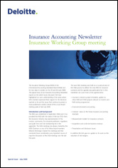
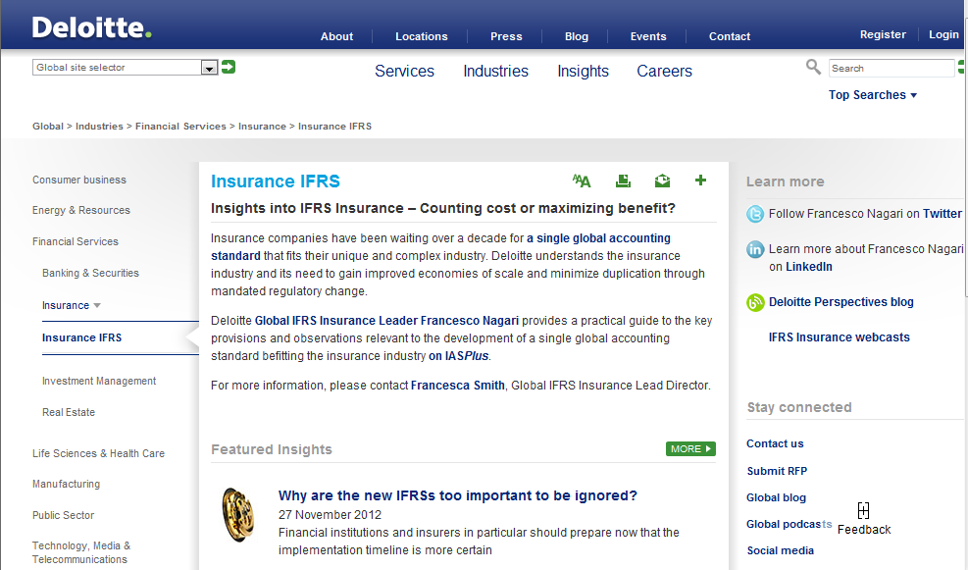
Contact details
Francesco Nagari
Deloitte Global IFRS Insurance Lead Partner
+44 20 7303 8375
fnagari@deloitte.co.uk
@Nagarif
Deloitte Insights into IFRS Insurance (i2ii)
www.deloitte.com/i2ii
Insurance Centre of Excellence:
insurancecentreofexc@deloitte.co.uk
IFRS 4 Phase II Webcast (March 2014)

Slide 26
Deloitte refers to one or more of Deloitte Touche Tohmatsu Limited (“DTTL”), a UK private company limited by guarantee, and its network of member firms, each of which is a legally separate and independent entity. Please see www.deloitte.co.uk/about for a detailed description of the legal structure of DTTL and its member firms.
Deloitte LLP is the United Kingdom member firm of DTTL.
This publication has been written in general terms and therefore cannot be relied on to cover specific situations; application of the principles set out will depend upon the particular circumstances involved and we recommend that you obtain professional advice before acting or refraining from acting on any of the contents of this publication. Deloitte LLP would be pleased to advise readers on how to apply the principles set out in this publication to their specific circumstances. Deloitte LLP accepts no duty of care or liability for any loss occasioned to any person acting or refraining from action as a result of any material in this publication.
Deloitte LLP is a limited liability partnership registered in England and Wales with registered number OC303675 and its registered office at 2 New Street Square, London EC4A 3BZ, United Kingdom. Tel: +44 (0) 20 7936 3000 Fax: +44 (0) 20 7583 1198.
© 2014 Deloitte LLP. All rights reserved.

